Slide 1



Document Capture with
I.R.I.S. scanning platform to
Microsoft SharePoint
End-to-end document capture, indexation, OCR to Microsoft SharePoint

Slide 2
Typical Company Needs
High speed scanning of documents
Separate, Classify and Rename these documents and Extract key data
Create and Compress into different types of searchable documents
Storage on a Document Management System according to document classification and extracted data

Slide 3

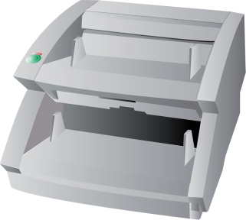
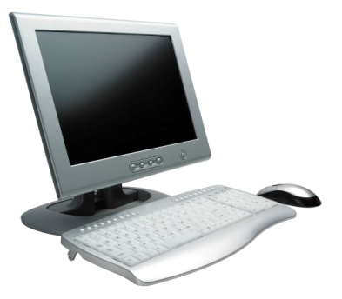

Low volume solution

Slide 4
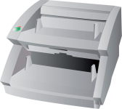
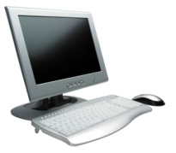
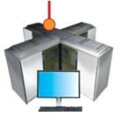

High volume solution

Slide 5


High speed scanning
Document separation & identification
Document creation and compression
Document creation and compression
Document storage

Slide 6
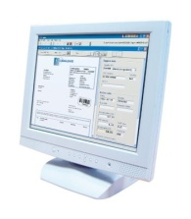
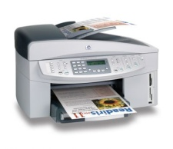

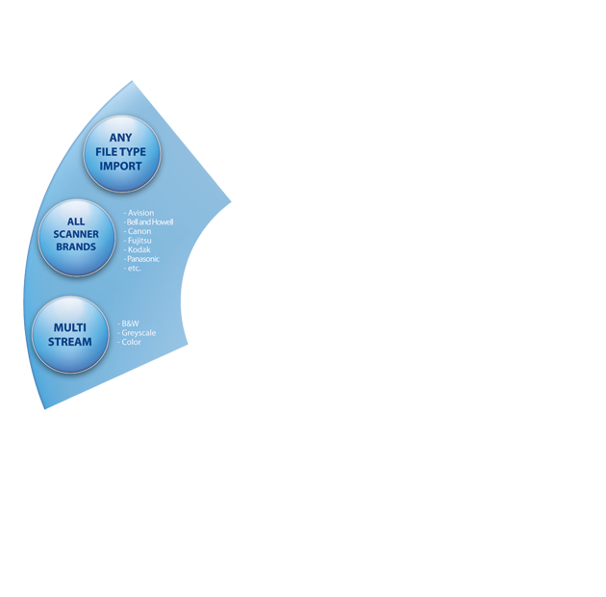
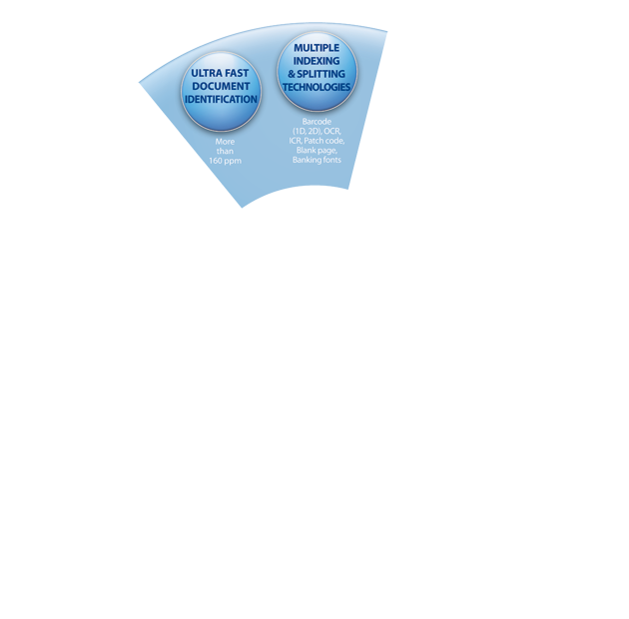
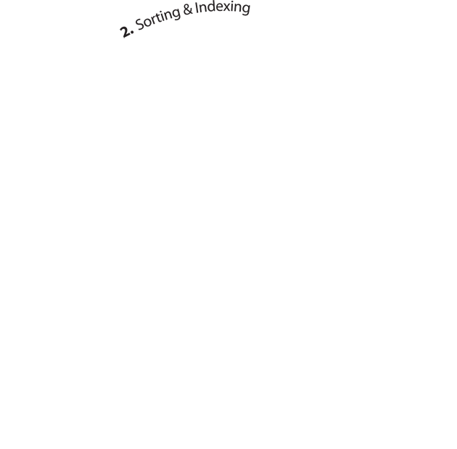

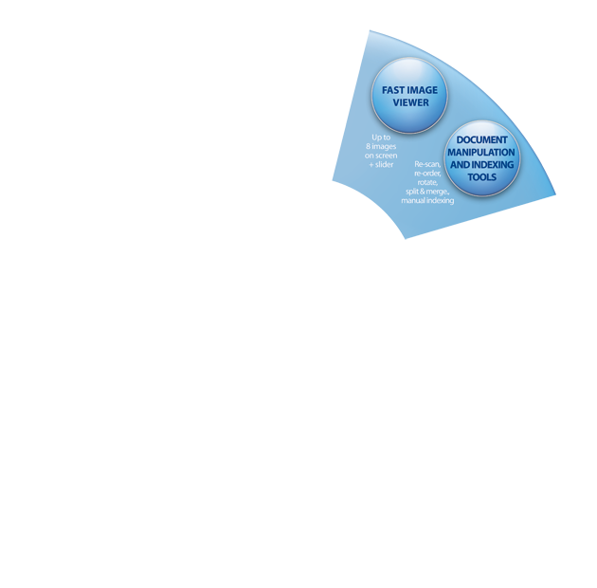


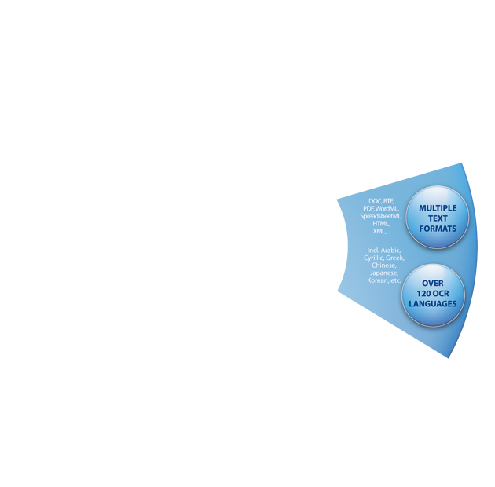


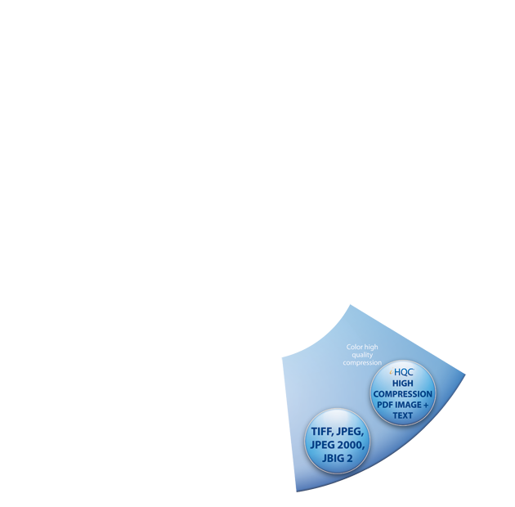


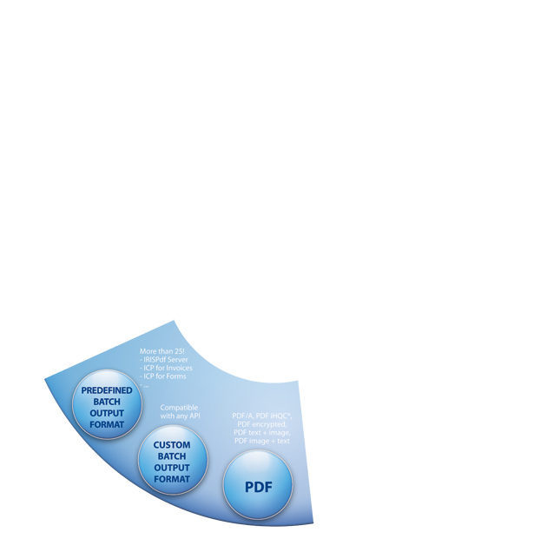


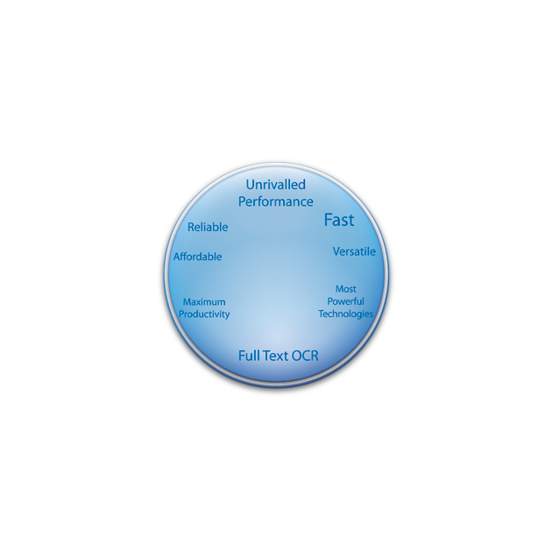

Connects to nearly any scanner
Project based with ready to use templates
User friendly interface that can be personalised
Functionality to control user rights and user interface
Can connect to other applications for post-processing of the documents such as Microsoft SharePoint

Slide 7
Capture
Pre-Processing
Recognition
Separation
Identification
Indexing
Quality Control
Document Creation
Export

Slide 8
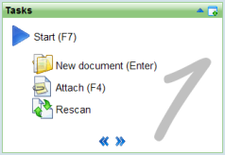
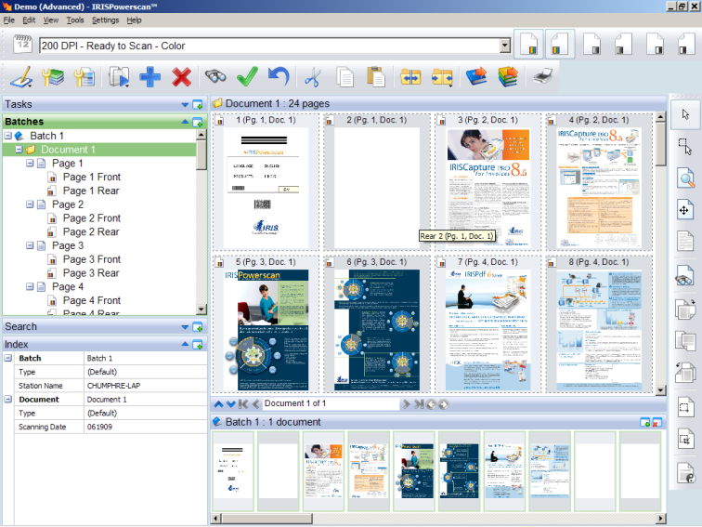
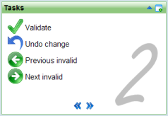
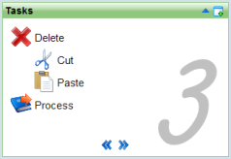
User’s workflow
Capture
Pre-Processing
For the user, there are just 3 processes:
Recognition
Scanning
Validation
Processing
Scanning
Separation
Identification
Validation
Indexing
Quality Control
Processing
Document Creation
Export

Slide 9




Very powerful image file to document converter
Can convert to many different formats such as searchable PDF, PDF/a, XPS, RTF, OpenDocument Text, MS Word, SpreadsheetML, XML, HTML…
Can compress PDF, PDF/a and XPS documents thanks to I.R.I.S. technology
Can digitally sign and protect your PDF files
Server type running 24/7 as a service

Slide 10
Capture
Pre-Processing
Recognition
Separation
Document Creation
Output
Export

Slide 11


Automatic
Capture
Pre-Processing
One process and all automatic
Running as a Windows Service
Recognition
Separation
Document Creation
Output
Export

Slide 12


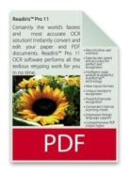


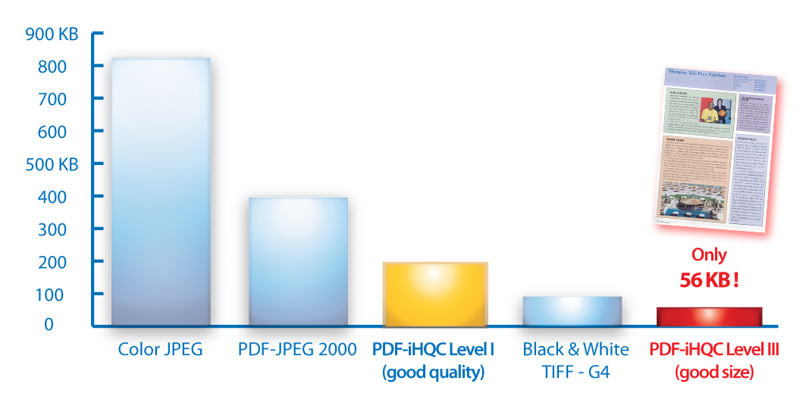
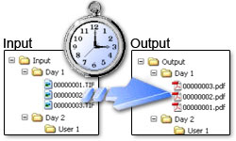
iHQC Advantages:
  The documents are MUCH smaller:
    The files take much less storage space
    The files can be sent over the network
  iHQC™ compression keeps the documents as legible as the original
  PDF, PDF/A and XPS iHQC™ files can be opened by the standard viewers
  + these documents are fully searchable

Slide 13





  I.R.I.S. IDR technology will:
  Separate & Identify the documents
  Index the documents according to type
  Create and compress to searchable documents
  Store them in the right folders with the indexes
Invoice 1
Supplier: AT&T
Date: 08.08.08
Mail 1
Subject: Vacation
Mail 2
Subject: Marriage
Invoice 2
Supplier: BT
Date: 07.07.07
Invoice 1.pdf
Mail 1.pdf
Mail 2.pdf
Invoice 2.pdf
Index.xml
Invoices
Supplier Date
Invoice1.pdf AT&T 08.08.08
Invoice2.pdf BT 07.07.07
Mails
Subject
Mail1.pdf Vacation
Mail2.pdf Marriage

Slide 14
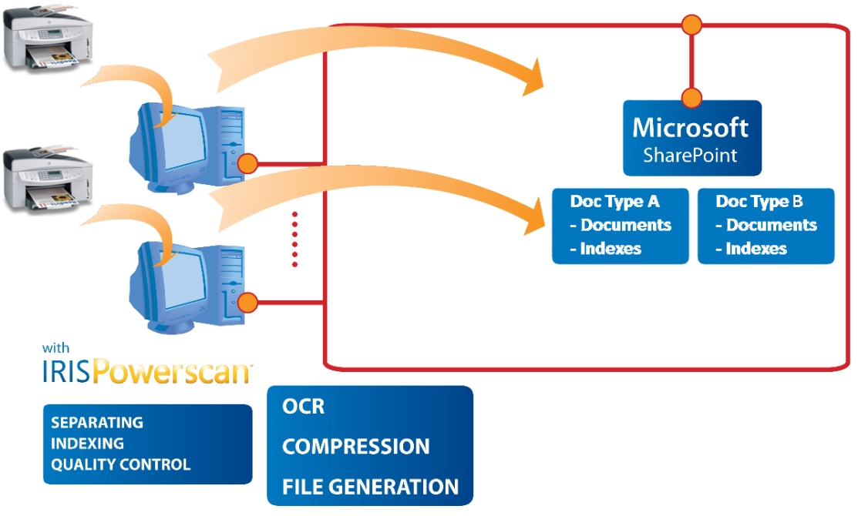
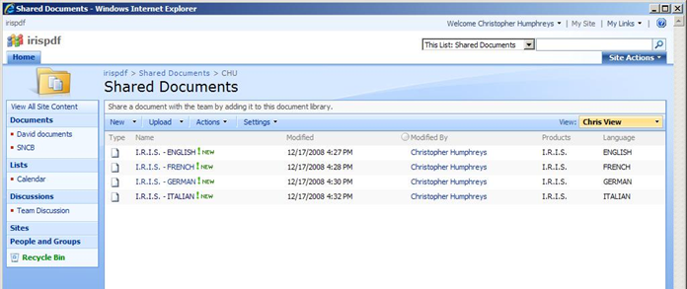
IRISPowerscan™ to SharePoint
IRISPowerscan™ Microsoft SharePoint
Different Document Types can be stored in different directories within Microsoft SharePoint
Documents
Indexes

Slide 15
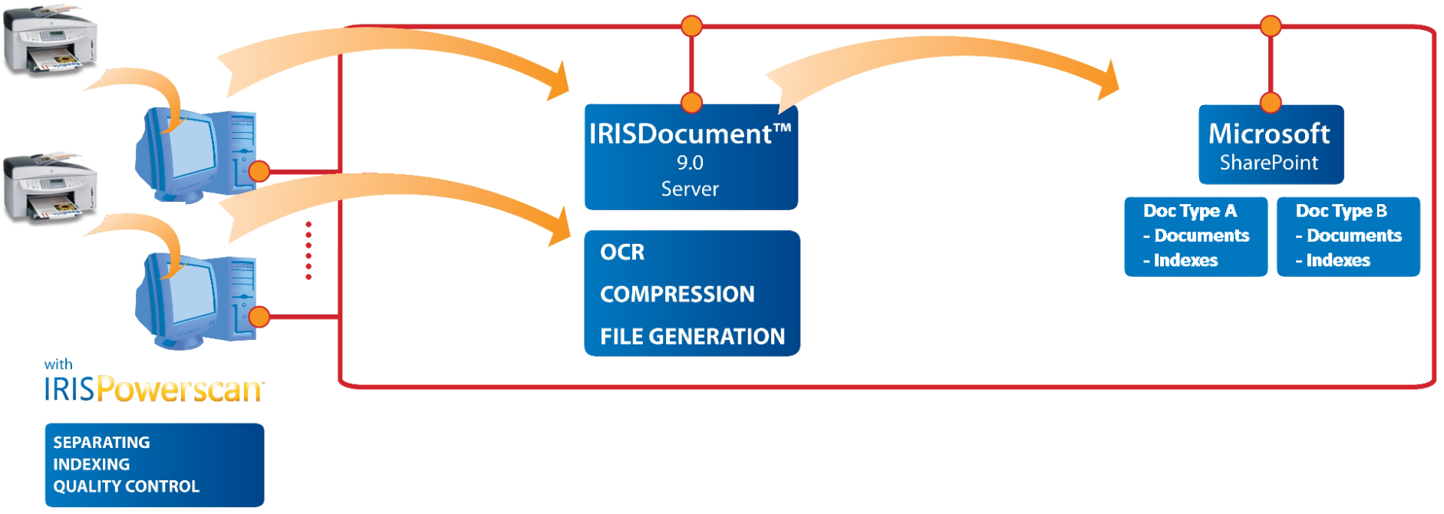
IRISPowerscan™ to SharePoint
IRISPowerscan™ IRISDocument™ Server Microsoft SharePoint
Documents
Indexes

Slide 16
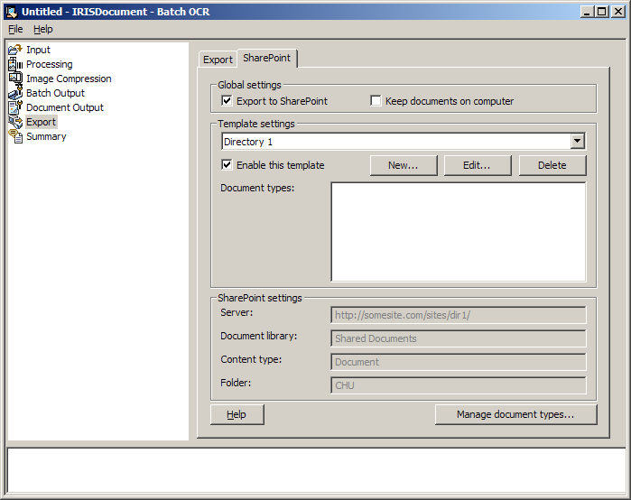
Microsoft SharePoint Add-on

Slide 17
Configuring
Activate this if you wish to send to SharePoint
Activate this if you wish to keep a copy of the documents on the PC
Templates – basically the directory settings to which you wish to send your documents. Use “default” if not with IRISPowerscan™

Slide 18
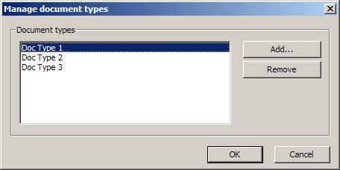
Configuring
Add document types by clicking on the “Manage document types” button

Slide 19
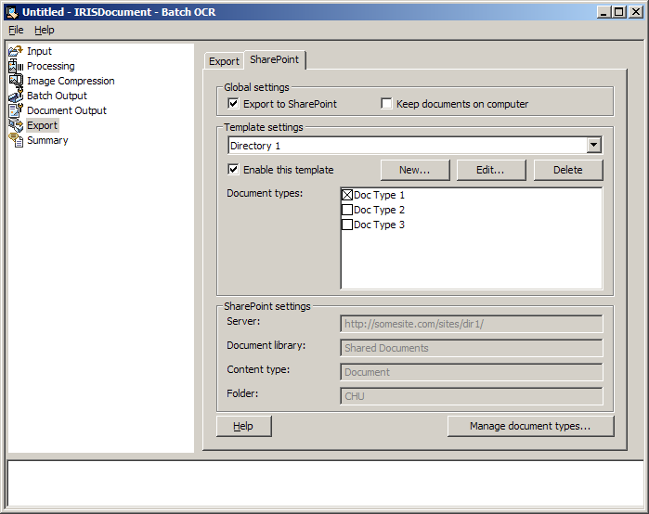
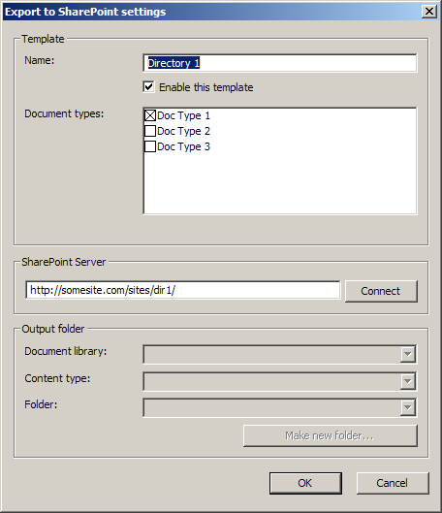
Configuring
Click on New or Edit to access the template edition page

Slide 20
Live demonstration

Slide 21
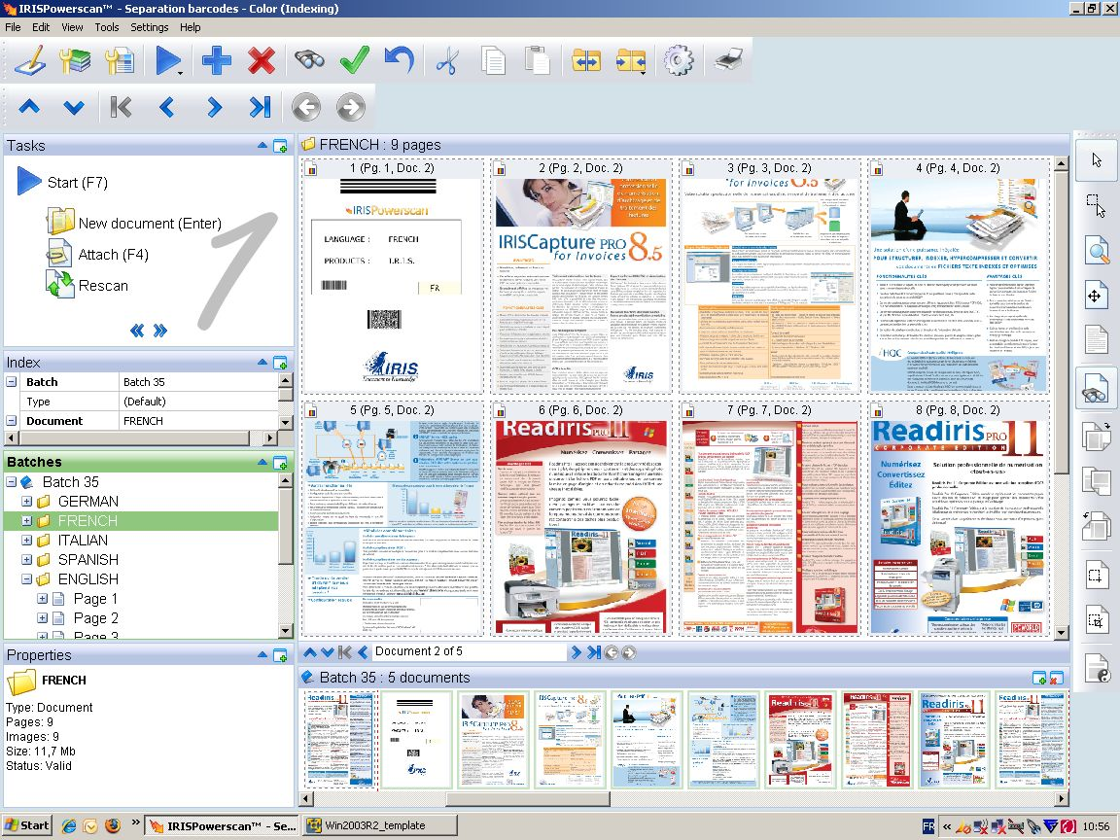
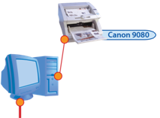
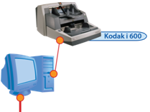





Microsoft SharePoint

Slide 22
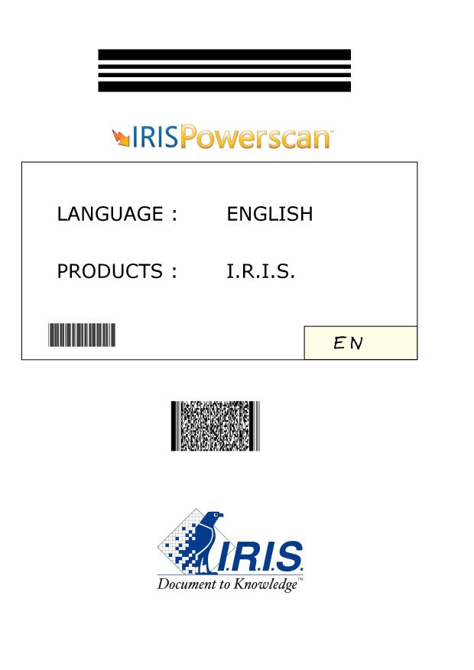

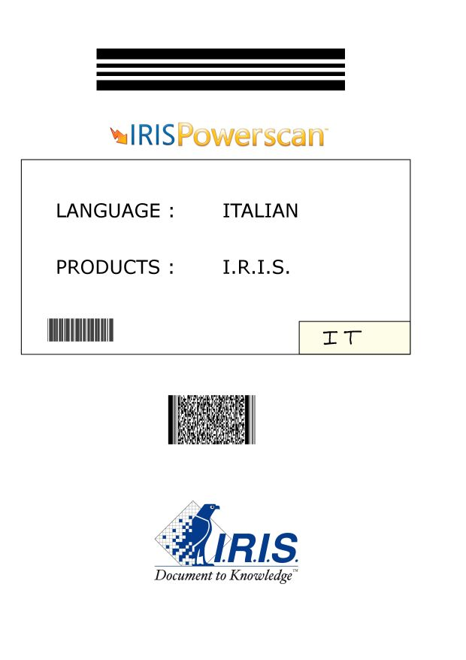

Separation & Indexing
The name of the document
(language of the brochures):
English
French
Spanish
Italian
German
Separator barcode
Index barcode
Scripting splits out:
- Client Name
- Client Number

Slide 23
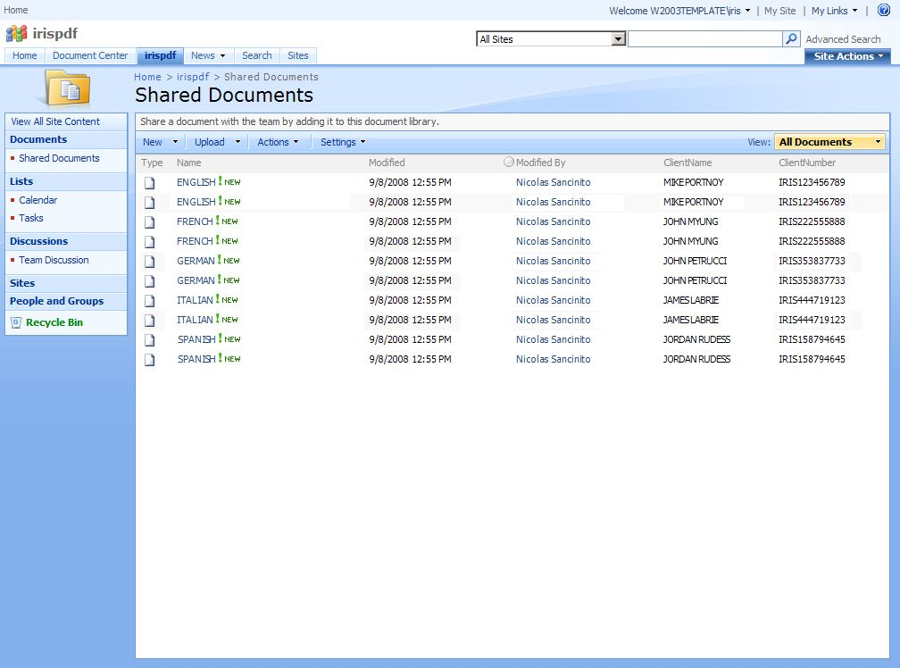

Slide 24
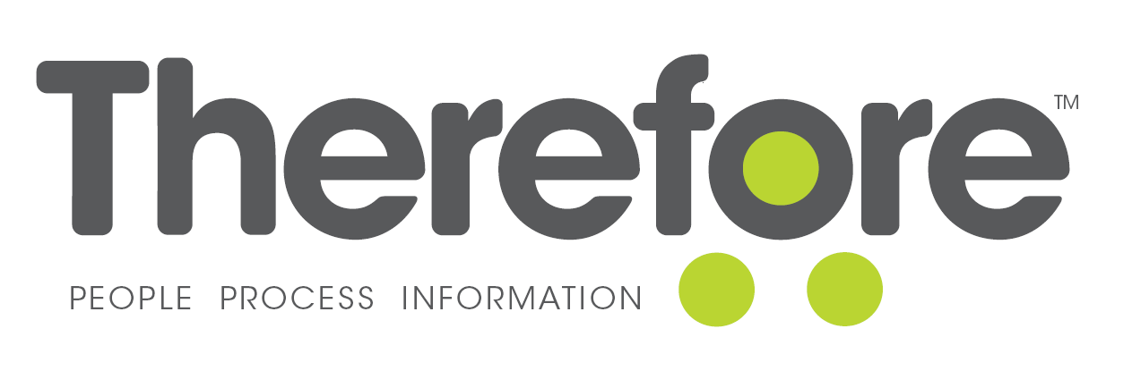
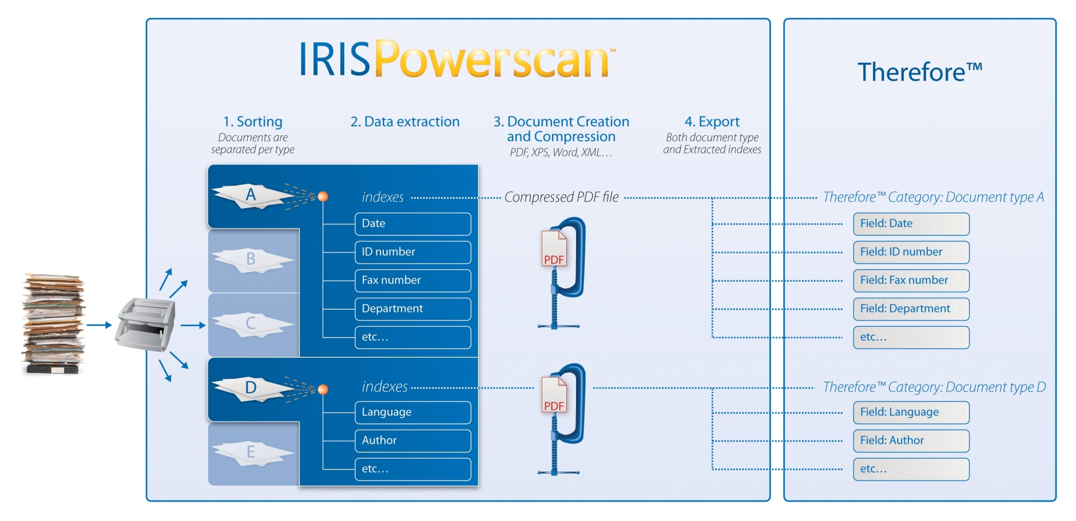

Other connectors
We have other connectors, like to Therefore™

Slide 25


Create you own Connector
API available in C++ and .Net
Samples included
An evolution to the old Kodak Capture Software BOF SDK => If you have created a previous BOF for KCS, it just needs recompiling…
If you do create a Connector, inform I.R.I.S. since it can be of mutual commercial benefit
Programming resources are available if needed. Our suggestion is hiring an I.R.I.S. Presales Engineer to sit with your developer and create the Connector together. => Takes just one day instead of days and be sure it is written correctly
I.R.I.S. is aiming to make this Connector SDK the ‘Connector’ SDK for all I.R.I.S. products. If you write a Connector it will be compatible with other I.R.I.S. applications in the near future

Slide 26



How to face your major challenge:
Do more with less, while reducing your carbon footprint
Scan more with less effort
Process more with less effort
Reduce the paper by converting it to electronic documents
Reduce the storage space needed with iHQC => less drives
Reduce the network bandwidth with iHQC => lighter networks

Slide 27


Thank you for your attention
Please visit our booths

